Slide 1



Science and Networking
Nima Rezaei, MD, PhD
Professor of Immunology
Head of the National Council of Students’ Scientific Research and Technology Committees
Head of Research Center for Immunodeficiencies
Vice Dean of Research, School of Medicine
Tehran University of Medical Sciences

Slide 2
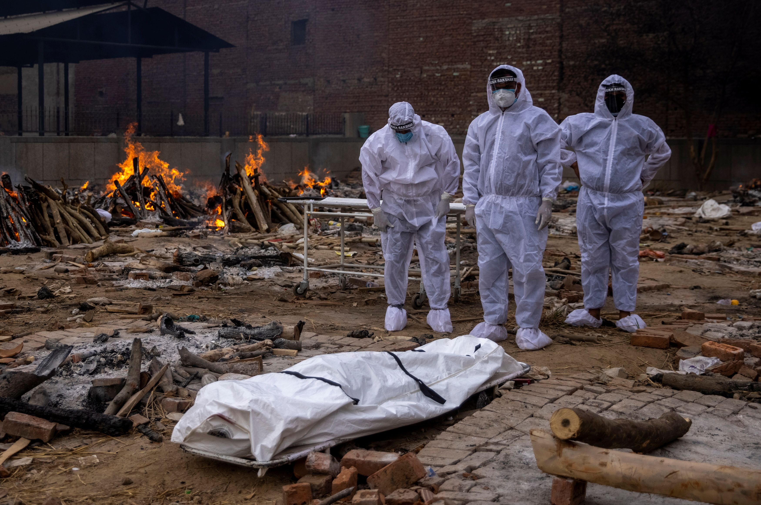
~700 million cases with COVID-19 and about 7 million deaths worldwide (since 2020)

Slide 3
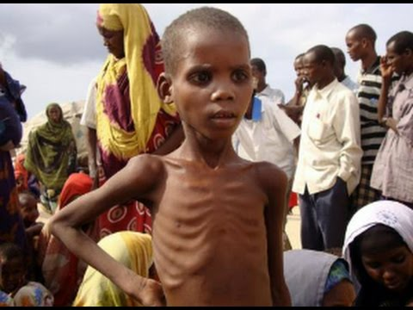
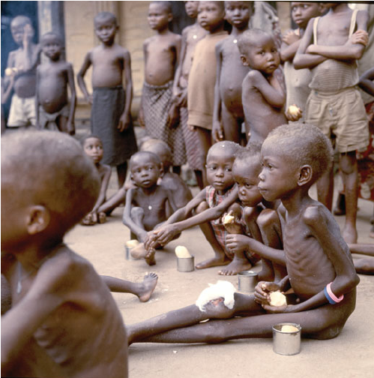
>90 million children under five are dangerously underweight.

Slide 4
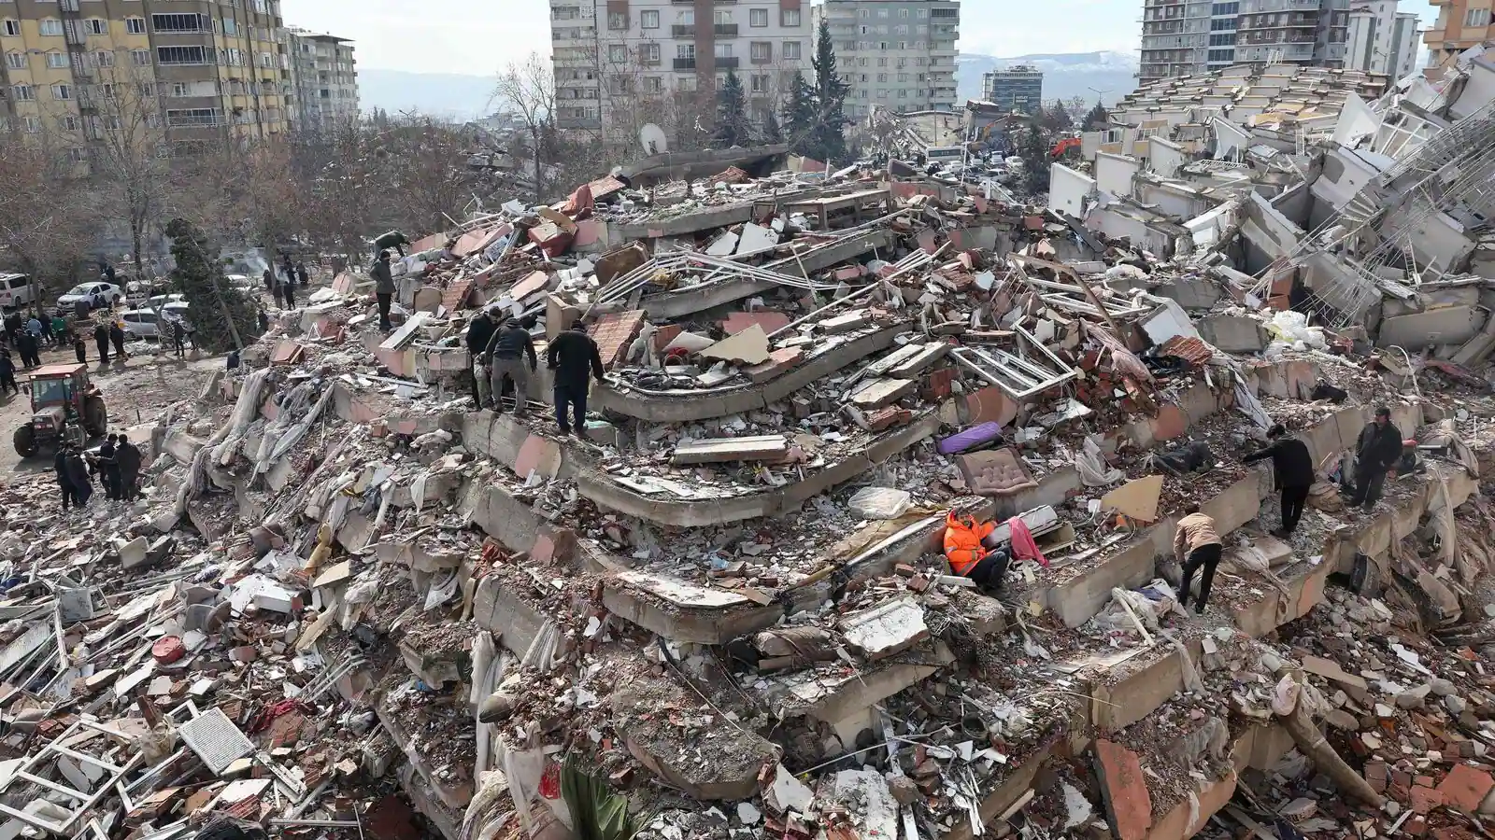
> 50,000 deaths in recent earthquake in Turkey and Syria (2023)

Slide 5
Complex Problem
Complex problems are by nature Borderless problems.
This calls for a Borderless solution
Therefore, INTEGRATION of Science could be a Solution!

Slide 6
COLLABORATE
Communication
Learning
Aims
Organization
Reviewing
Orientation
Altruism
Time management
Ethics
Liability
Borders

Slide 7
COLLABORATE
Communication
Learning
Aims
Organization
Reviewing
Orientation
Altruism
Time management
Ethics
Liability
Borders
Communication

Slide 8
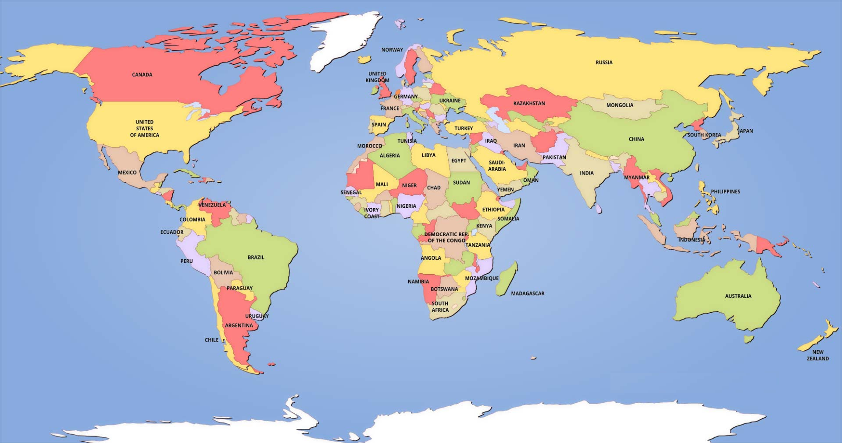
Thinking International

Slide 9
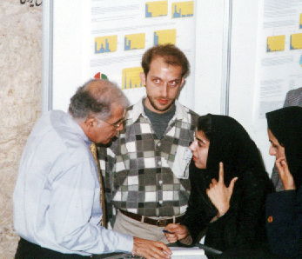
Presenting a Poster as a Medical Student
2000

Slide 10
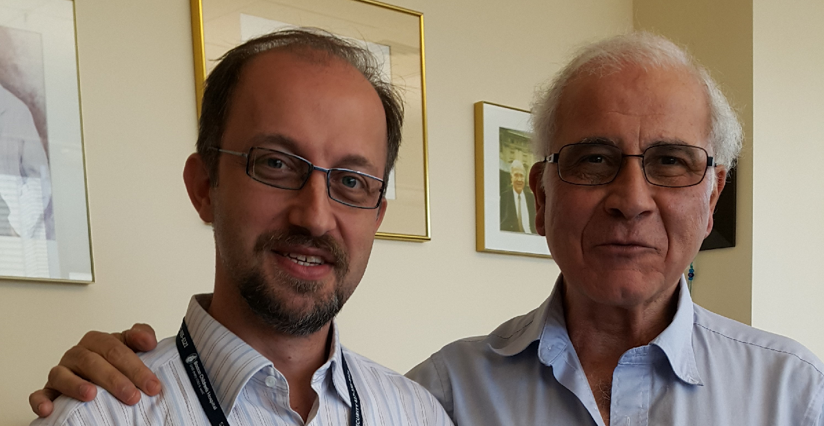
MoU with Harvard Medical School
2011

Slide 11
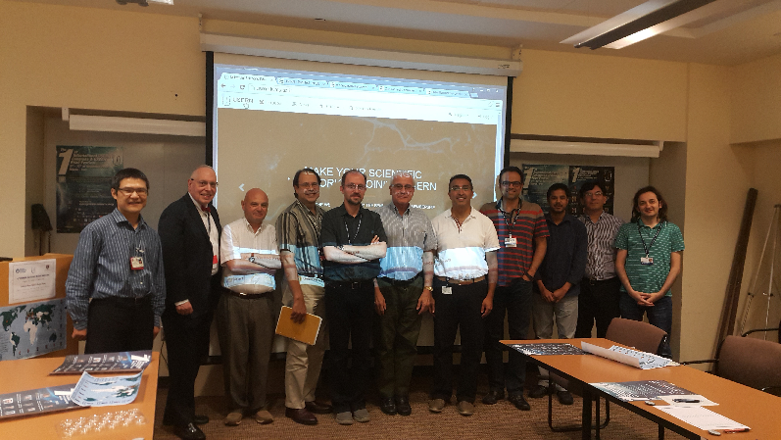
USERN Advisory Board Meeting
& Visiting Scientist 2016

Slide 12
International Collaborative Projects
Although some projects was performed with help and comments from international well-known PID experts, contribution in international projects, especially those that led to discovering specific phenotypes and genetic defects had a major impact in improving the science in this field.
Reporting four cases from Iran, Sweden and Spain with IgA deficiency that progressed to CVID could suggest that these diseases may have share phenotype and underlying genetic defect, which is not limited to a country. Consequently, further genetic studies on patients with IgA deficiency and CVID were designed.
Reporting some patients with Hyper IgM syndromes with no mutation in CD40, CD40L, AID and UNG genes encourage scientists for more studies in this group of patients for identification of new gene defect(s).

Slide 13
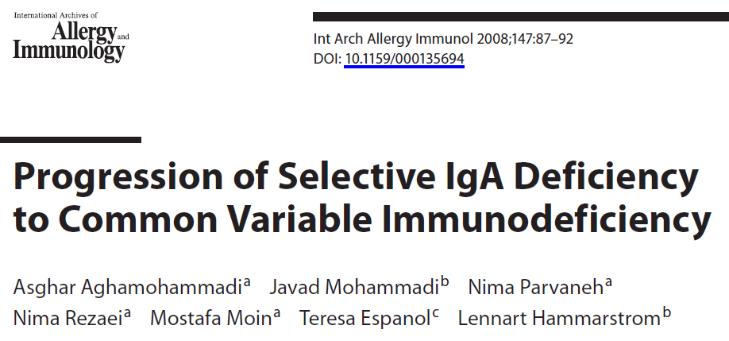
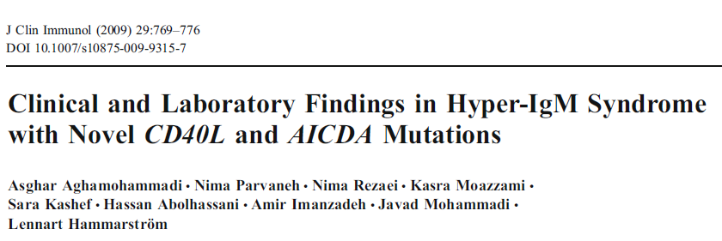
International Collaborative Projects

Slide 14
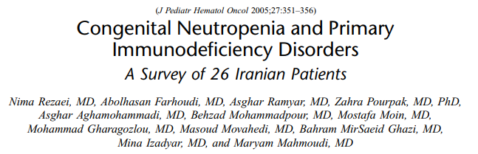
International Collaborative Projects
* Rezaei N, et al. J Pediatr Hematol Oncol. 2005;27(7):351-6.
* Rezaei N, et al. Haematologica. 2005;90(4):554-6.
* Salipante SJ, et al. Hum Mutat. 2007;28(9):874-81.
* Rezaei N, et al. J Clin Immunol. 2007;27(5):525-33.
* Klein C, et al. Nat Genet. 2007;39(1):86-92.
* Boztug K, et al. N Engl J Med. 2009;360(1):32-43.
* Boztug K, et al. J Pediatr. 2012 Apr;160(4):679-683.
* Abdollahpour H, et al. Blood. 2012 Apr 12;119(15):3450-7.
* Majnoon MT, et al. Pediatr Hematol Oncol. 2014 Mar;31(2):109-16.

Slide 15
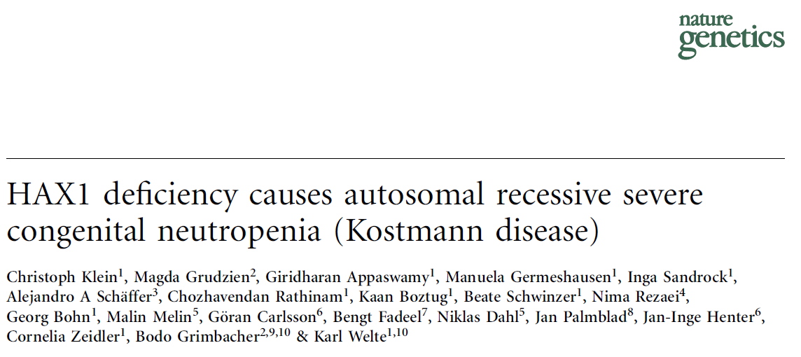

Slide 16
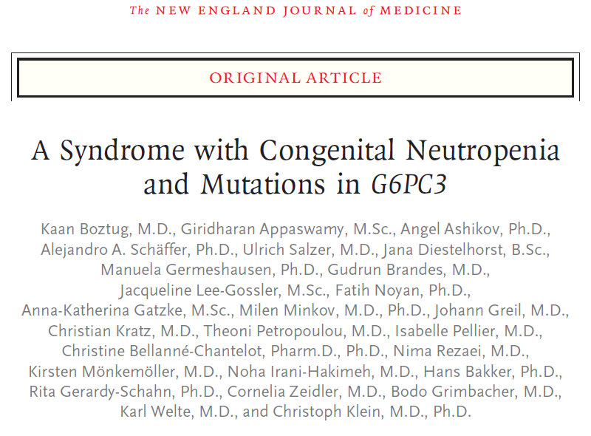


Slide 17
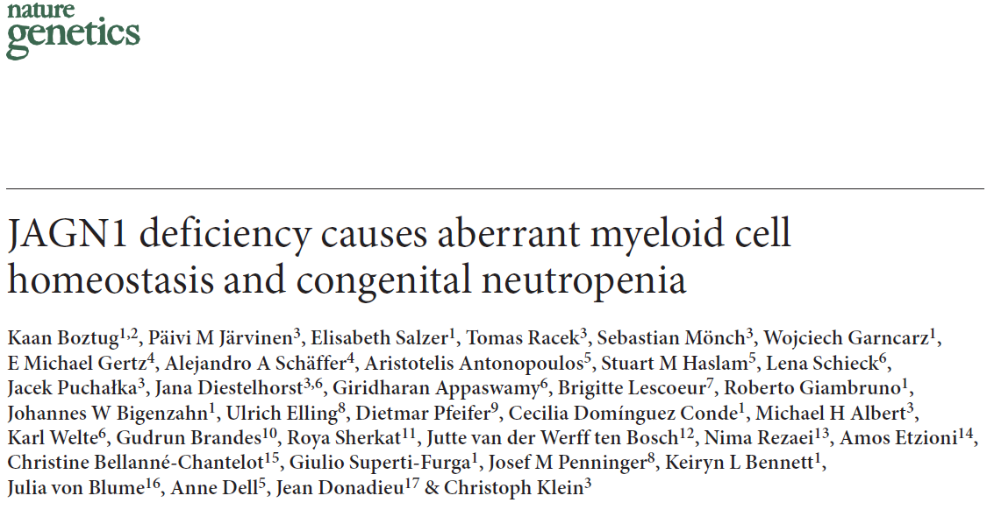

Slide 18


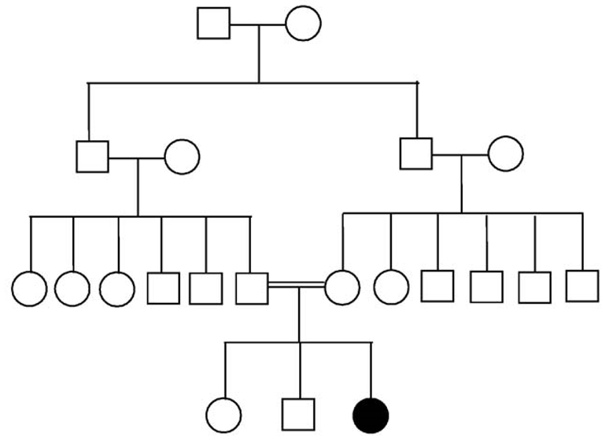
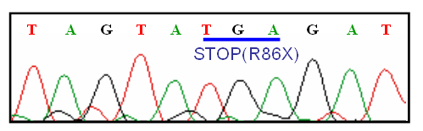
Neurological disorders
R86X mutation in HAX1 gene

Slide 19
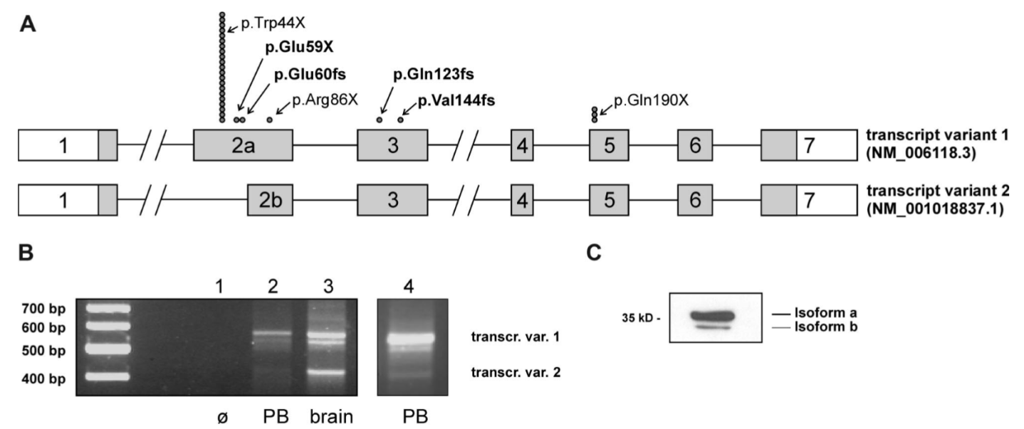
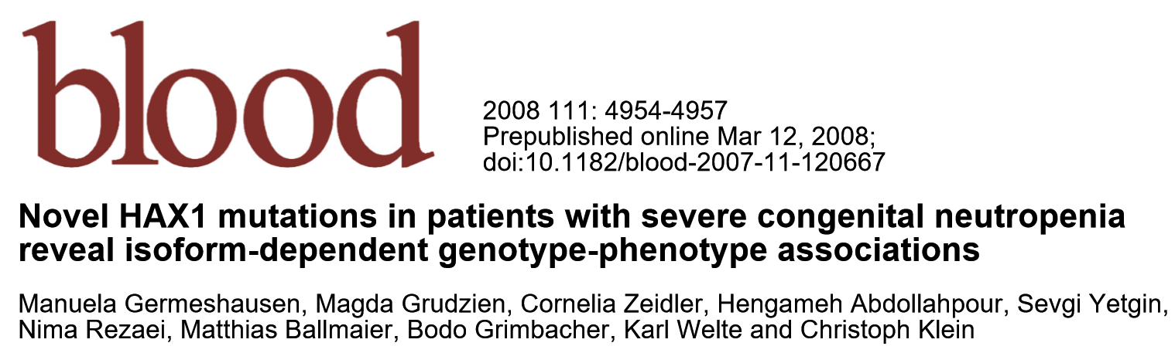
Genotype-Phenotype associations in HAX1 deficiency
Mutations affecting transcript variant 1 only were associated with SCN, whereas mutations affecting both transcript variants caused CN and neurologic symptoms
Transcript variant 2 was markedly expressed in human brain tissue
The clinical phenotype of SCN appears to depend on the localization of the mutation and their influence on the transcript variants

Slide 20
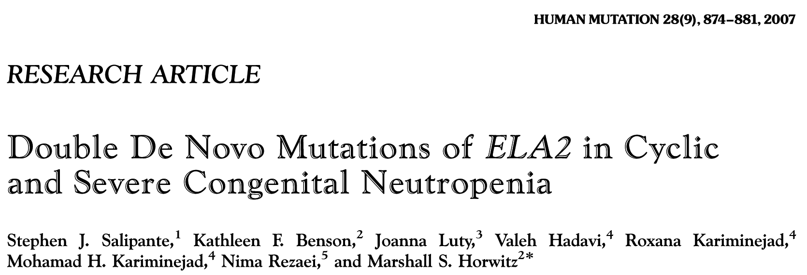
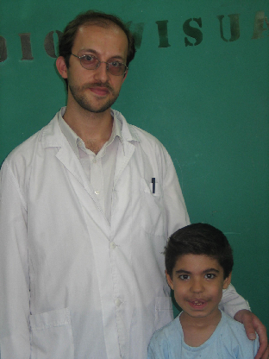
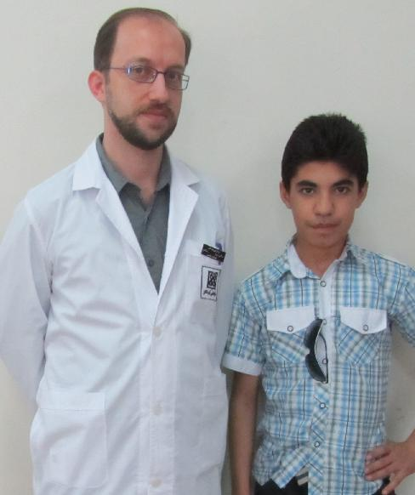

Slide 21
International Collaborative Projects
Determination of mutation in the CARD9 gene in an Iranian family with susceptibility to fungal infections
Contribution in the paper on patients with Mendelian susceptibility to mycobacterial disease who had mutations in IFNGR2 gene
Contribution in the paper on DOCK8 mutations in hyper-IgE syndrome
Contribution in the paper of identification of TRIF gene mutation in children with herpes simplex encephalitis
Contribution in new paper on novel genetic disorder due to mutation in the STK4 gene.
and contribution in a new paper on mutations of the LRBA gene in association with a syndrome of immunodeficiency and autoimmunity
Discovering a new gene defect due to mutation of CD70 gene
are some other achievements which were made based on an international collaboration.
* Glocker EO, et al. N Engl J Med. 2009;361(18):1727-35.
* Engelhardt KR, et al. J Allergy Clin Immunol. 2009;124(6):1289-302.
* Vogt G, et al. Nat Genet. 2005;37(7):692-700.
* Sancho-Shimizu V, et al. J Clin Invest. 2011 Dec 1;121(12):4889-902.
* Lopez-Herrera G, et al. Am J Hum Genet.2012 Jun 8;90(6):986-1001.
* Abolhasani H, et al. 2017 J Exp Med. 2017 Jan;214(1):91-106.

Slide 22
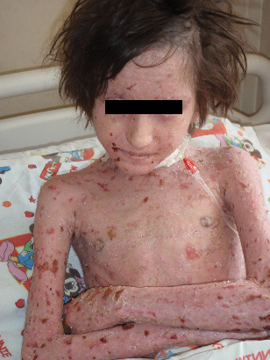
An 8-year old girl with severe eczema and mullouscum contagiosum.
Erythrodermia of the skin since early infancy.
History of recurrent respiratory infections.
Eosinophilia (550/mm³) and mild anemia.
Normal serum immunoglobulin levels except high IgE
IgA:44.3 mg/dl
IgG:1912 mg/dl
IgM:150 mg/dl
IgE:14.000 IU/ml
Dx: Hyper IgE syndrome
Which kind of treatment do you recommend?

Slide 23
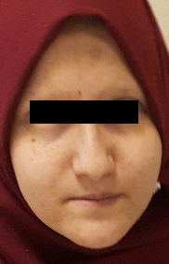
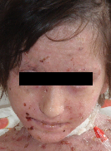
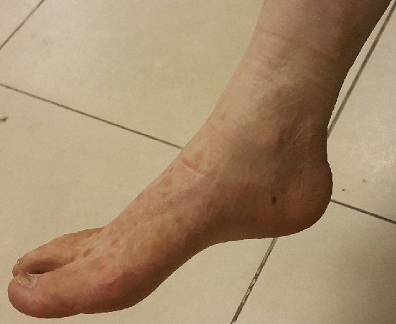
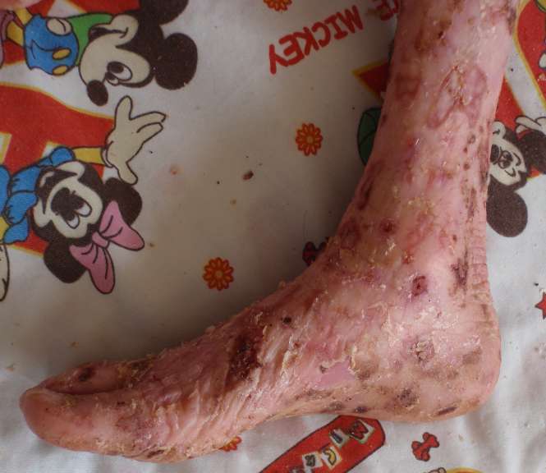
HSCT
After
Before

Slide 24
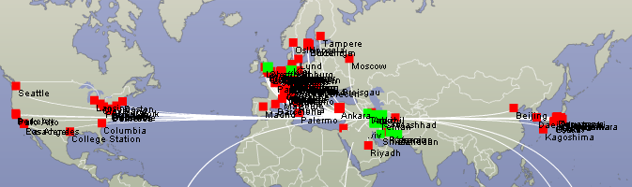
Scientific Output
Karolinska University Hospital (Sweden),
Hannover Medical School (Germany),
Freiburg University Hospital (Germany),
National Institute of Health (USA),
University College of London (UK),
University of Washington (USA),
Toyama Medical and Pharmaceutical University (Japan),
University of Brescia (Italy),
University of Sheffield (UK).

Slide 25
Collaborating Centers
* Division of Clinical Immunology, Department of Laboratory Medicine, Karolinska Institutet at the Karolinska University Hospital Huddinge, SE-141 86 Stockholm, Sweden
* Division of Rheumatology and Clinical Immunology, Medical Center, Freiburg University Hospital, Freiburg, Germany
* Department of Infection and Immunity, School of Medicine and Biomedical Sciences, The University of Sheffield, Sheffield, United Kingdom
* Department of Immunology and Molecular Pathology, Royal Free Hospital & University College Medical School, London, UK
* Department of Pediatric Hematology and Oncology, Hannover Medical School, Hannover, Germany
* Clinica Pediatrica e Istituto di Medicina Molecolare Angelo Nocivelli, University of Brescia, Brescia, Italy
* Department of Pediatrics, Faculty of Medicine, Toyama Medical and Pharmaceutical University, Toyama, Japan
* Department of Immunology and Immunodeficiencies, Hospital Vall d´Hebron, School of Medicine, Barcelona, Spain
* Division of Medical Genetics, Department of Medicine, University of Washington, Seattle, USA
* Department of Pediatric Oncology, Hematology and Clinical Immunology, University Hospital Duesseldorf, Heinrich-Heine-University, Duesseldorf, Germany

Slide 26
Collaborating Centers
* National Institute of Allergy and Infectious Diseases, National Institutes of Health, Bethesda, MD, USA
* Type I Diabetes Center, La Jolla Institute for Allergy and Immunology, La Jolla, CA, USA
* St. Giles Laboratory of Human Genetics of Infectious Diseases, The Rockefeller University, New York, NY, USA
* Division of Immunology, and the Jeffrey Modell Immunology Center at Harvard, Children's Hospital Boston, Harvard Medical School, Boston, MA, USA
* Division of Immunology, Children's Hospital of Philadelphia, School of Medicine, University of Pennsylvania, Philadelphia, PA, USA
* Center for Immunity and Immunotherapies, and the Jeffrey Modell Chair of Pediatric Immunology Research, Seattle Children's Research Institute, University of Washington, Seattle, WA, USA
* The Department of Pediatrics and Adolescent Medicine, Medical University of Vienna, Vienna, Austria
* The CeMM Research Center for Molecular Medicine of the Austrian Academy of Sciences, Vienna, Austria
* The Pediatric Department, Children’s University Hospital Bratislava, Comenius University Medical Faculty, Bratislava, Slovak Republic
* The Department of Infectious and Pediatric Immunology, Medical and Health Science Centre, University of Debrecen, Debrecen, Hungary
* Department of Pathology and Immunology, Geneva Medical Faculty, University of Geneva; and the Department of Genetic and Laboratory Medicine, Geneva University Hospitals, Geneva, Switzerland

Slide 27
Collaborating Centers
* The Children's Memorial Health Institute, Warsaw, Poland
* Department of Immunology-Histocompatibility, and Specific Center & Referral Center for Primary Immunodeficiencies – Paediatric Immunology, "Aghia Sophia" Children's Hospital, Athens, Greece
* The European Laboratory for the Investigation of Food-Induced Diseases (ELFID), Università degli Studi di Napoli Federico II, Naples, Italy
* Department of Immunology, Azerbaijan Medical School, Baku, Azerbaijan
* The Belorusian National Research Center for Pediatric Oncology, Hematology and Immunology, Minsk Region, Belarus
* The Jeffrey Modell Diagnostic and Research Center in São Paulo, Brazil
* Division of Allergy, Clinical Immunology and Rheumatology, Department of Pediatrics, Federal University of São Paulo, and Jeffrey Modell Diagnostic and Research Center in São Paulo, Brazil
* Emory Vaccine Center, School of Medicine, Emory University, Atlanta, Georgia, USA
* Department of Immunology, INSERM, Laboratory of Excellence (LabEx) Transplantex, Strasbourg Federation for Translational Medicine (FMTS), Strasbourg School of Medicine and University Teaching Hospitals, University of Strasbourg, Strasbourg, France
* The Laboratory of Research, and Department of Immunology, Institut Pasteur de Tunis, Tunis
* The Clinical Immunology Unit, Casablanca Children’s Hospital, Universite Hassan II Casablanca, Casablanca, Morocco
* Division of Pediatric Allergy/Immunology, Marmara University Hospital, Marmara University, Istanbul, Turkey

Slide 28
Scientific Output
- Contribution of the Iranian scientists in the scientific output of the world has been increased since 1970, particularly at the threshold of the 21st century.
- Based on performed research projects in the field of PID, more than 500 articles and some books have been published. The number of published papers in the field of PID in international journals which are indexed in the major databases, including ISI Web of Knowledge, Medline (Pubmed) and Scopus was significantly increased during last decade.
- Searching the Scopus, using the keywords of "primary immunodeficiency" and some other specific immunodeficiencies and combination with address of "Iran" indicated more than 50,000 publications worldwide in the field of PIDs; among them more than 400 papers have been published and the scientific output of the country has been increased meantime.

Slide 29
Scientific Output
- While only 1-5 papers per year had been published in this field at beginning of 21st century from Iran, the number of publication has been increased to >30/year during last decade.

Slide 30
Scientific Output
- In respect to rapid progress in scientific output of the country, Iran is among top 20 countries that have role in scientific output in the field of PIDs recent years with about 2% of total publication during last decade.

Slide 31
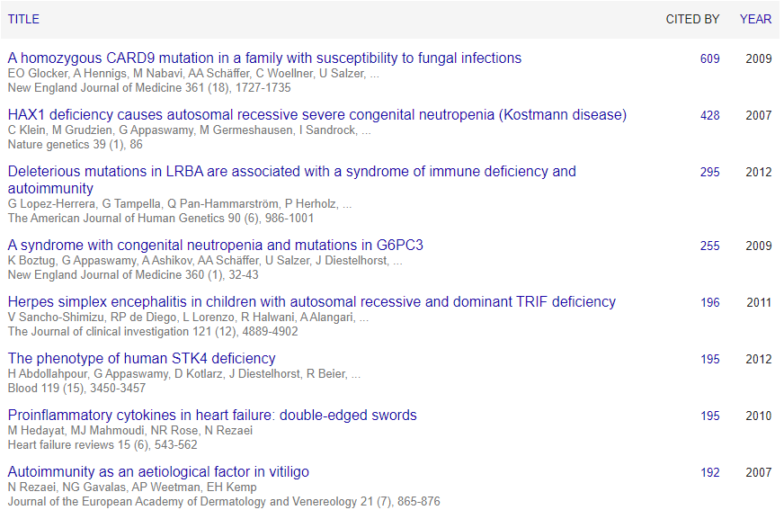

Slide 32
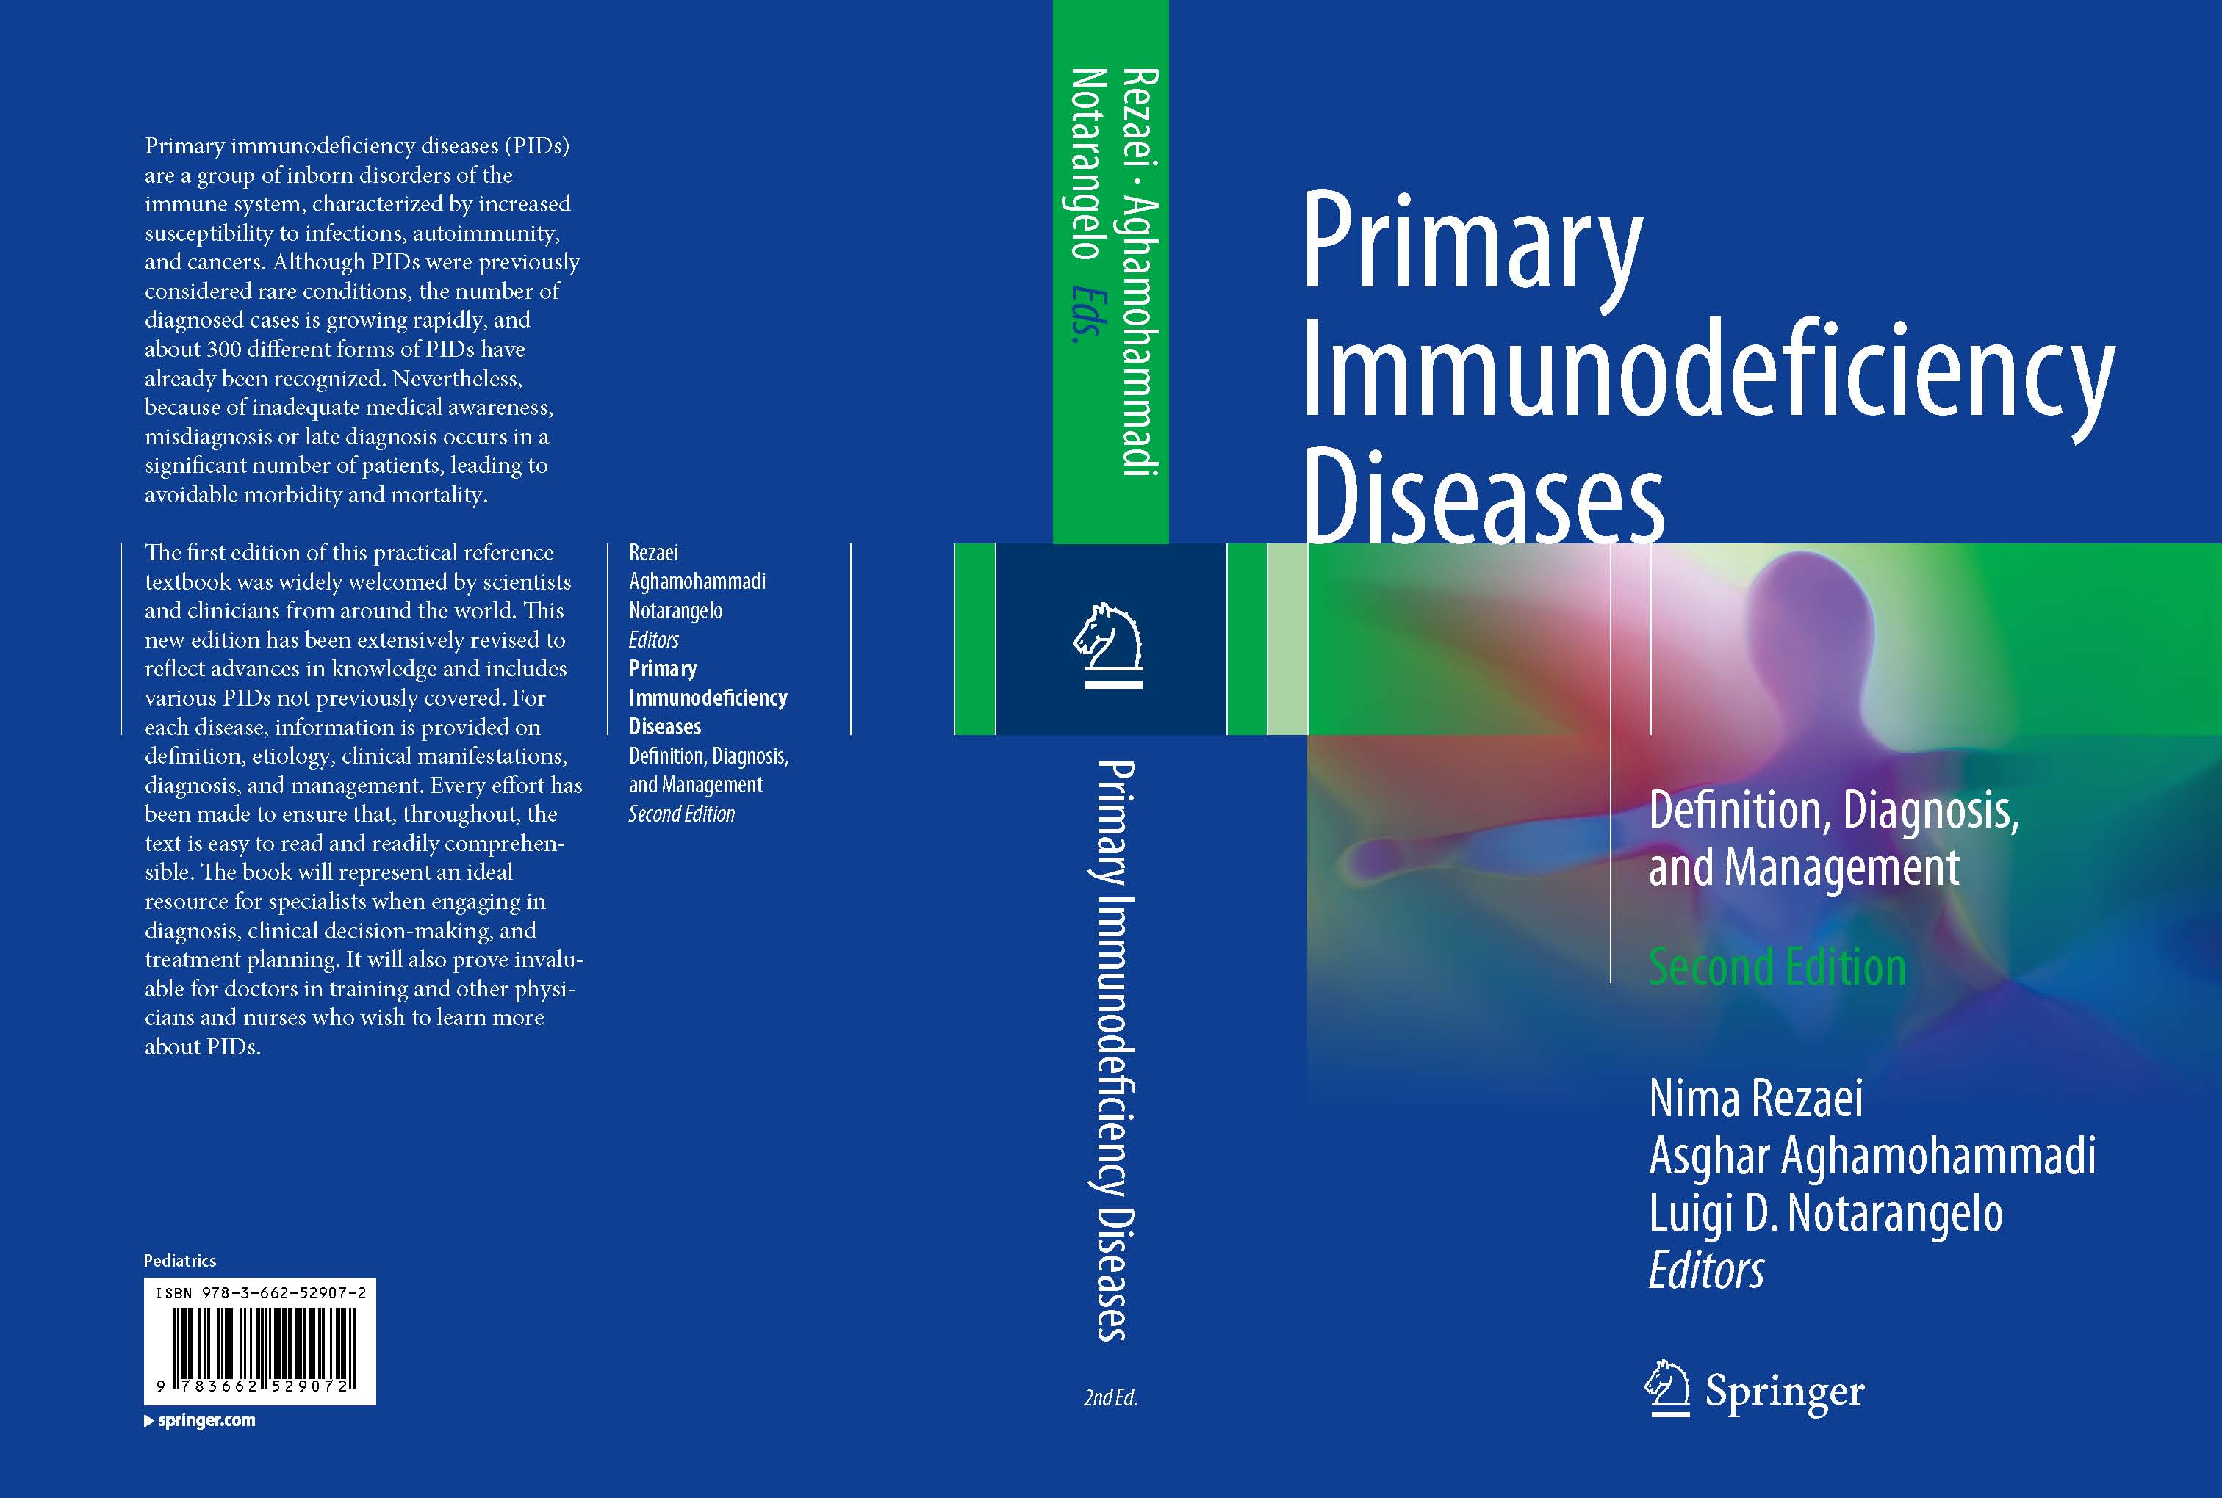
Primary Immunodeficiency Diseases: Definition, Diagnosis and Management. 2nd Edition. By Rezaei N, Aghamohammadi A, Notarangelo LD. Springer 2016

Slide 33
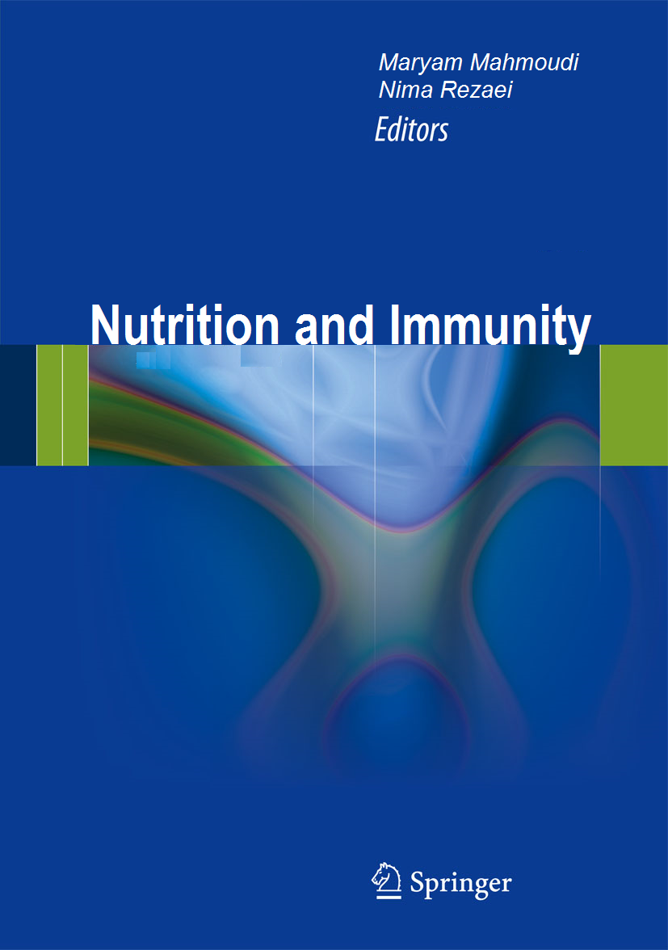

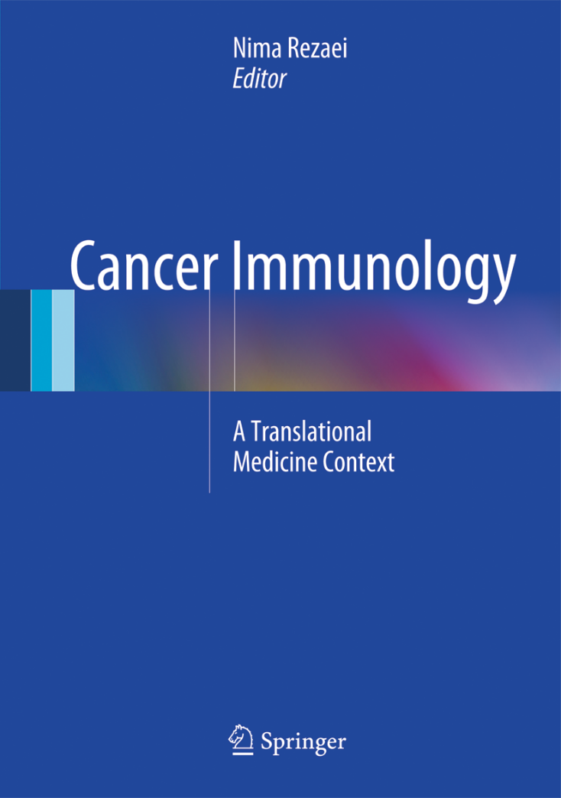
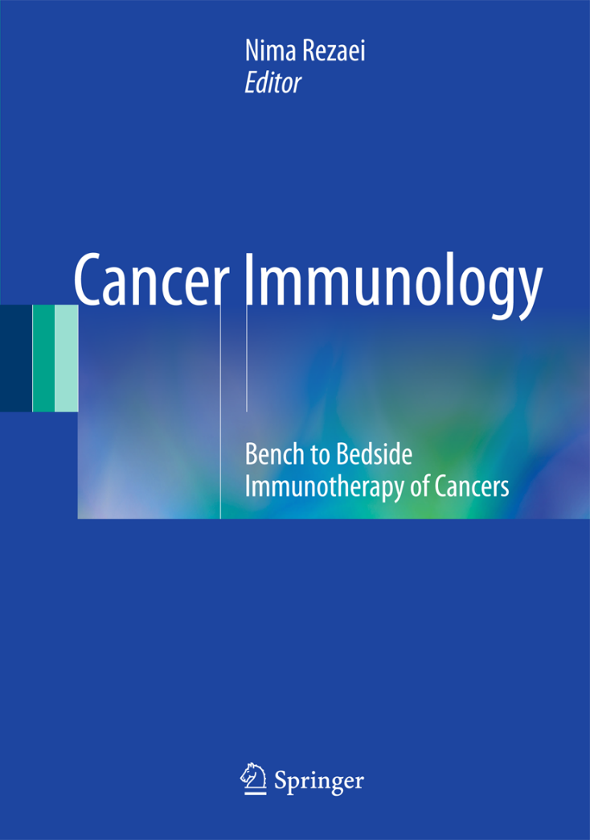
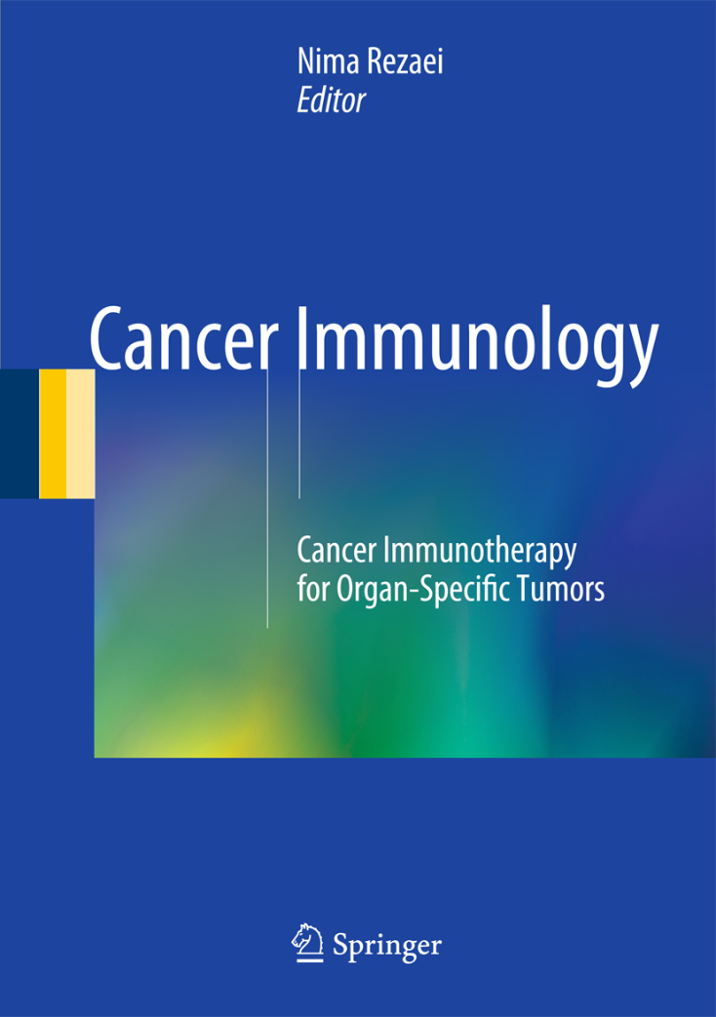
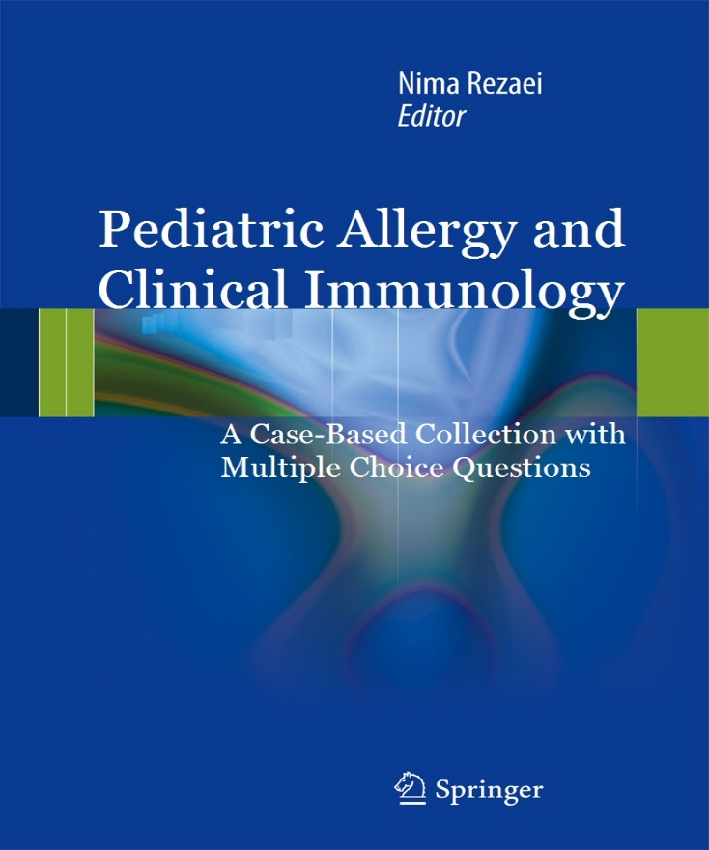
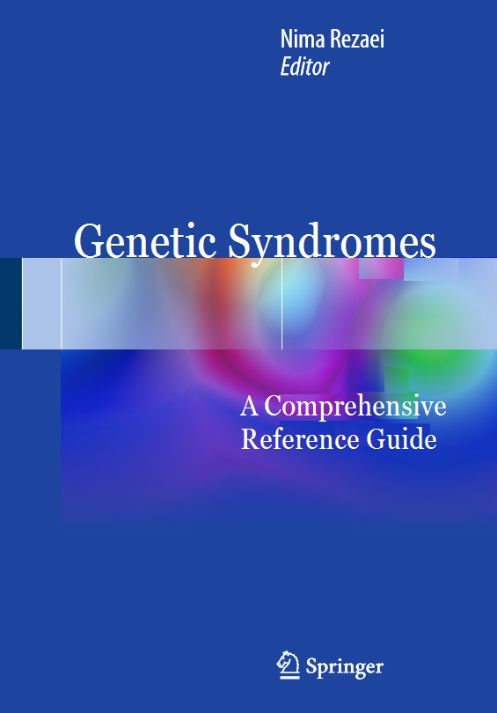
2018
2018
2nd edition in 2019
2018
2020

Slide 34
COLLABORATE
Communication
Learning
Aims
Organization
Reviewing
Orientation
Altruism
Time management
Ethics
Liability
Borders
Orientation

Slide 35
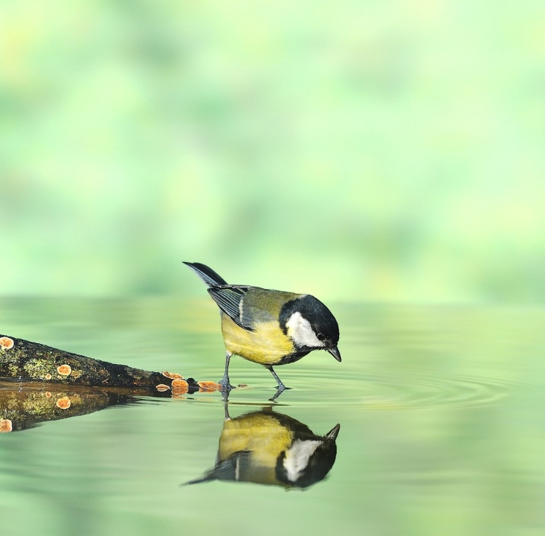
S trengths
w eakness
O pportunity
T hreat

Slide 36
Self-knowledge
“I do not Know
why the people are curious to Know each others
instead of Knowing themselves”
Nima REZAEI

Slide 37
COLLABORATE
Communication
Learning
Aims
Organization
Reviewing
Orientation
Altruism
Time management
Ethics
Liability
Borders
Learning

Slide 38

Research Skills
Doing a Research
Research Skills
Problem Solving
Analysis
Critical Thinking
Dissemination

Slide 39
Skills
Doing a Research
Writing a Proposal
Research Skills
Teamwork
Communication Skills
Step 3
Step 2
Step 1
Project Management Skills
Writing Skills
Creativity Skills
Educational Skills

Slide 40
COLLABORATE
Communication
Learning
Aims
Organization
Reviewing
Orientation
Altruism
Time management
Ethics
Liability
Borders
Liability

Slide 41


Slide 42

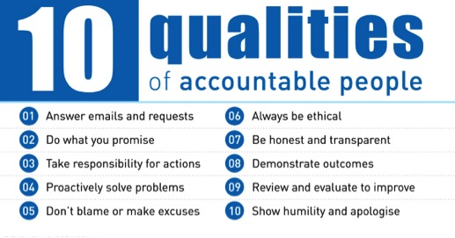
Accountability

Slide 43
COLLABORATE
Communication
Learning
Aims
Organization
Reviewing
Orientation
Altruism
Time management
Ethics
Liability
Borders
Aims

Slide 44

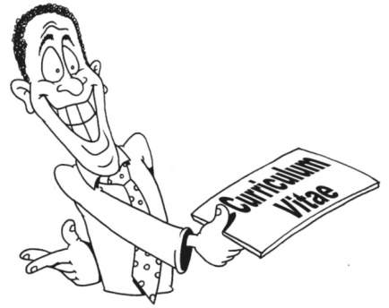
Why Should We Do Research?
Increasing the Knowledge
Ensuring scientific thoroughness
Allowing discussion and feedback
Motivating of scientists
Improving chances of funding
Promoting career
  Document productivity
  Document impact on field/reputation
  Advertises your center for future trainees

Slide 45
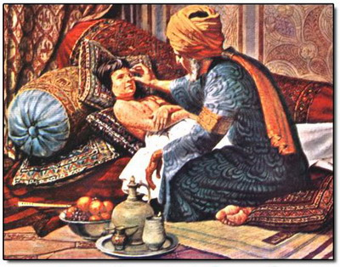
Iranian Researchers
Muhammad ibn Zakariya al-Razi
(854-925)
Smallpox vs. measles
Pharmacy
Ethics of medicine

Slide 46
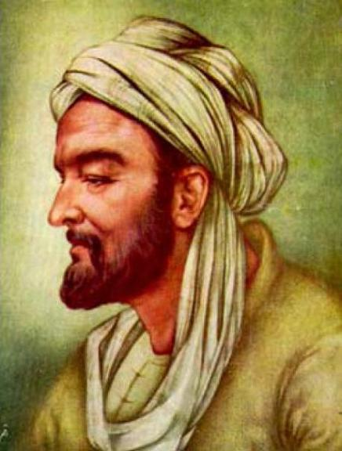
Iranian Researchers
Avicenna (980-1037)
The Canon of Medicine:
The drug must be free from any extraneous accidental quality.
It must be used on a simple, not a composite, disease.
The drug must be tested with two contrary types of diseases, because sometimes a drug cures one disease by Its essential qualities and another by its accidental ones.
The quality of the drug must correspond to the strength of the disease. For example, there are some drugs whose heat is less than the coldness of certain diseases, so that they would have no effect on them.
The time of action must be observed, so that essence and accident are not confused.
The effect of the drug must be seen to occur constantly or in many cases, for if this did not happen, it was an accidental effect.
The experimentation must be done with the human body, for testing a drug on a lion or a horse might not prove anything about its effect on man.

Slide 47
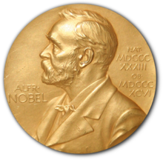
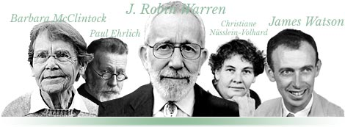
Nobel Laureates in
Physiology or Medicine
The Nobel Prize in Physiology or Medicine has been awarded 113 times to 225 Nobel Prize laureates between 1901 and 2022.

Slide 48
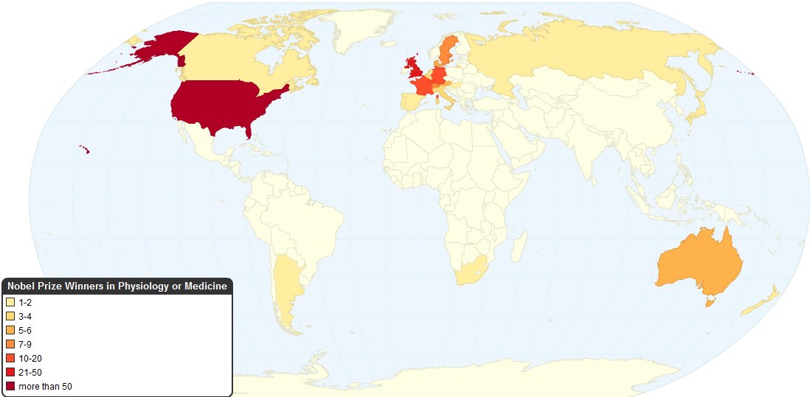
Who is the next!?
Is there still anything to be discovered!?

Slide 49
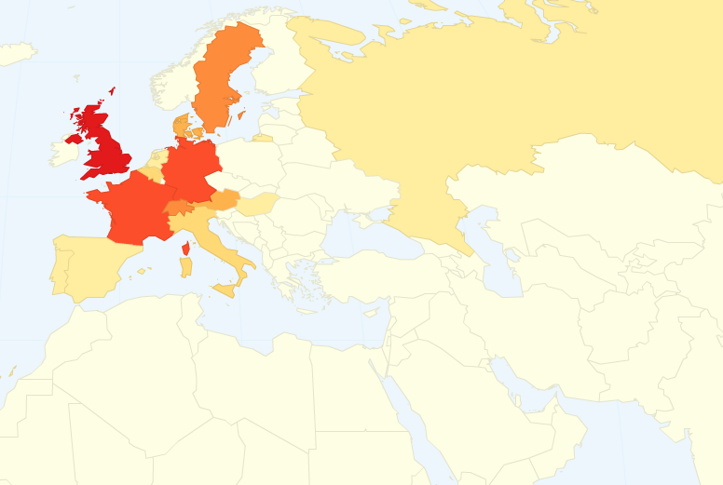
And from which country!?
Any chance to be in the list? ☹

Slide 50

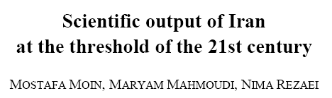
Scientific Output of IRAN

Slide 51
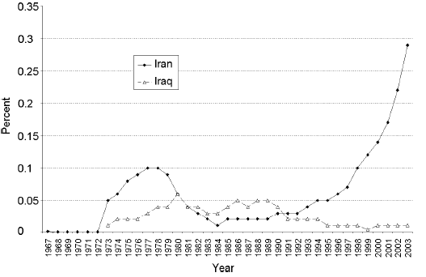
Scientific Output of
Iran and Iraq

Slide 52
COLLABORATE
Communication
Learning
Aims
Organization
Reviewing
Orientation
Altruism
Time management
Ethics
Liability
Borders
Borders

Slide 53
Our Vision is Dark
due to not only
our Knowledge Limitation,
but also our implemented Borders
Nima REZAEI

Slide 54
We are all limited to
the Borders of a Dark Room
Nima REZAEI

Slide 55
COLLABORATE
Communication
Learning
Aims
Organization
Reviewing
Orientation
Altruism
Time management
Ethics
Liability
Borders
Organization

Slide 56

Networking
Or No Working
That is the Question!

Slide 57

Universal Scientific Education and Research Network (USERN)

Slide 58
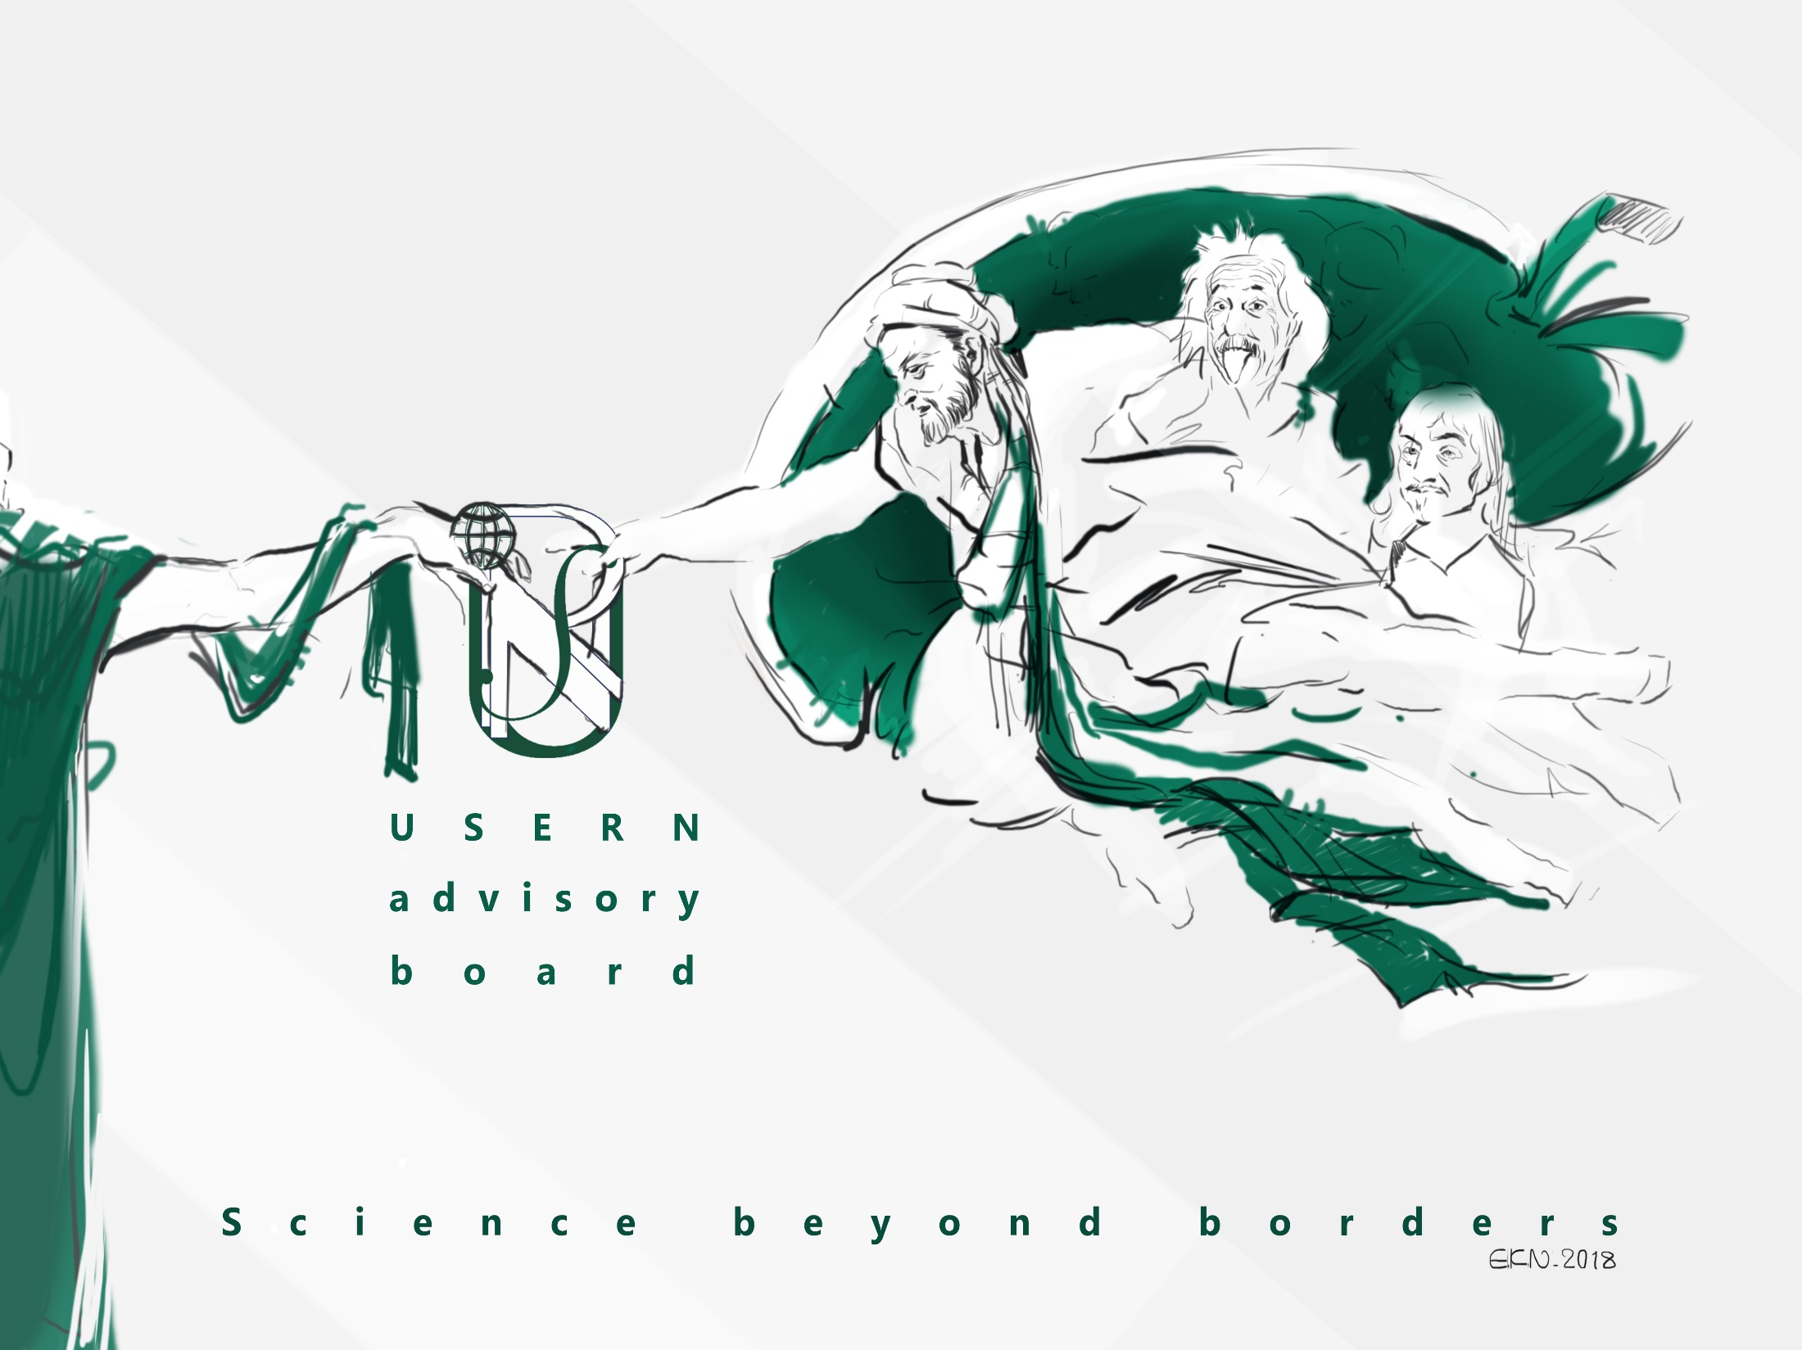
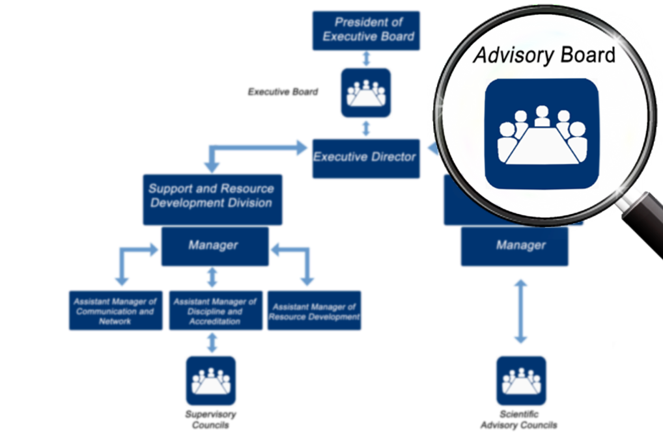
Nobel and Abel laureates
Top 1% scientists of each 22 scientific fields according to ESI
Recommendation by one of the advisory board to be considered
Notes:
این اسلاید بعد از organizational chart بیاد تا اسلاید 9

Slide 59
Nobel Laureates
Paul Greengard (USA) Medicine, 2000
John Gurdon (UK) Medicine, 2012
Jules Hoffmann (France) Medicine, 2011
Martin Karplus (USA) Chemistry, 2013
Yuan T. Lee (Taiwan) Chemistry, 1986
Jean-Marie Lehn (France) Chemistry, 1987
Eric S. Maskin (USA) Economy, 2007
Erwin Neher (Germany) Medicine, 1991
Stanley B. Prusiner (USA) Medicine. 1997
Akira Suzuki (Japan) Chemistry, 2010
Oliver E. Williamson (USA) Economy, 2009
Kurt Wuthrich (Switzerland) Chemistry, 2002
Robert Huber (Germany) Chemistry, 1988

Slide 60


Observation
> 900 events
Expectation
~ 300 events
2016
2017
2018
2019
2020
2021
2022

Slide 61
USERN in Brief
Over 22,000 Members
Over 600 Advisors
17 Nobel Laureates and 2 Abel Laureates among USERN Advisors
Over 70 Interest Groups
50 USERN Offices
U100: 130 MoUs and Offices
62 UJAs
More than 2000 publications (H-index: 77)
And >900 Event including Congresses, Spring Events, Research Weeks, Workshops, Schools, Talks, iTalks, mTalks, Junior Talks, UEEEs, FGDs, Panels

Slide 62
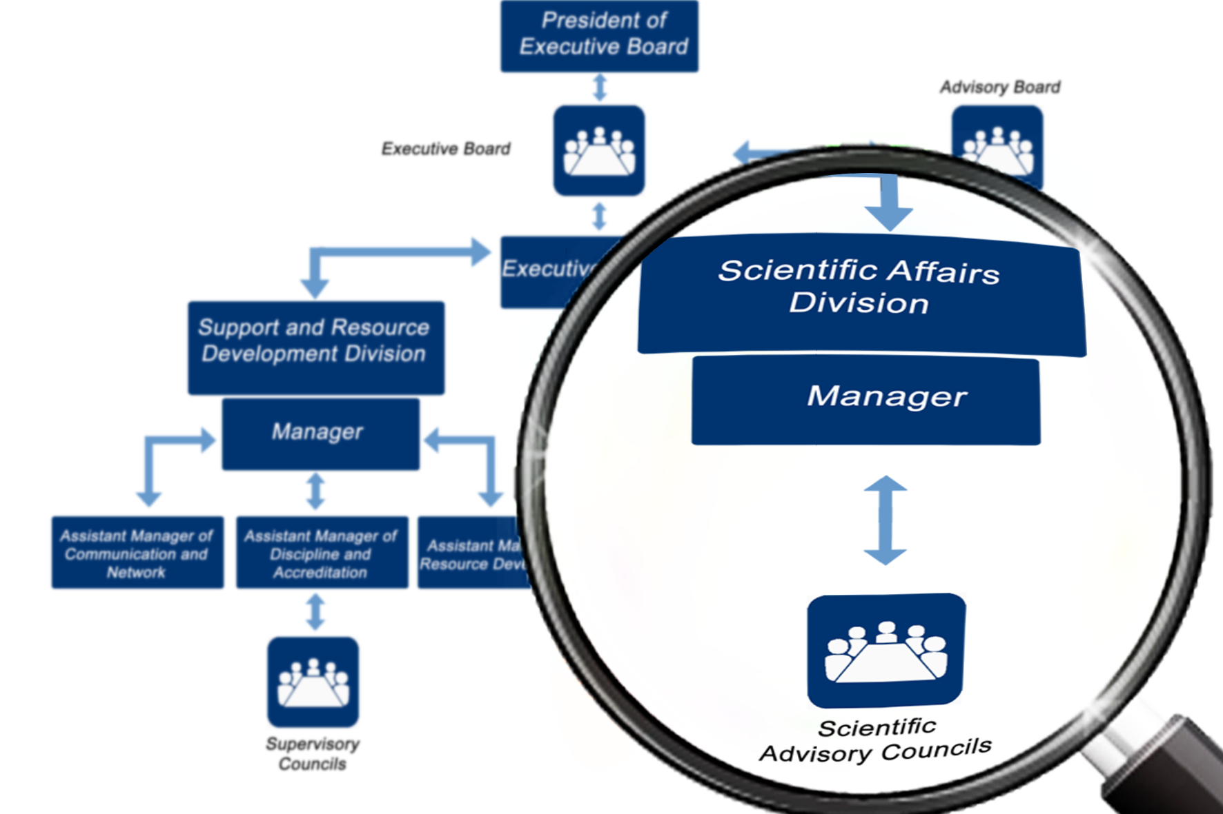

Slide 63
Current Interest Groups #82
Cancer Immunology Project (CIP)
Border of Immune Tolerance Education and Research Network (BITERN)
Health and Art (HEART)
NeuroImmunology Research Association (NIRA)
Network of Immunity in Infection, Malignancy and Autoimmunity (NIIMA)
Dietitians and Nutrition Experts Team (DiNET)
Primary Immunodeficiency Diseases Network (PIDNet)
Rheumatology Expert Group (REG)
Nature of Gene Mutation Group (NGMG)
Global Stem Cell and Regenerative Medicine Network (GSCRM Net)
Nano-Encapsulation in the Food, Nutraceutical, and Pharmaceutical Industries Group (NFNPIG)
Association for Multidisciplinary Research on Aging (AMRA)
Tissue Engineering and Regenerative Medicine International Group (TERMIG)
Hematology Research Association (HRA)
Medical Laser and New Technology Network (MLNTNet)
Cardiovascular Surgery Association (CVSA)
Reproductive Health and HIV Association (RH-HIVA)
Pelvic Floor Rehabilitation and Urotherapy Group (PFRUG)
Computational Medicine and Cancer Biology Network (CMCBN)
International Otorhinolaryngology Research Association (IORA)
Genomic and Connectomics, Interdisciplinary Neuroscience Group (GCING)
Pediatric Respiratory Diseases Education and Research Network (PRDERN)

Slide 64
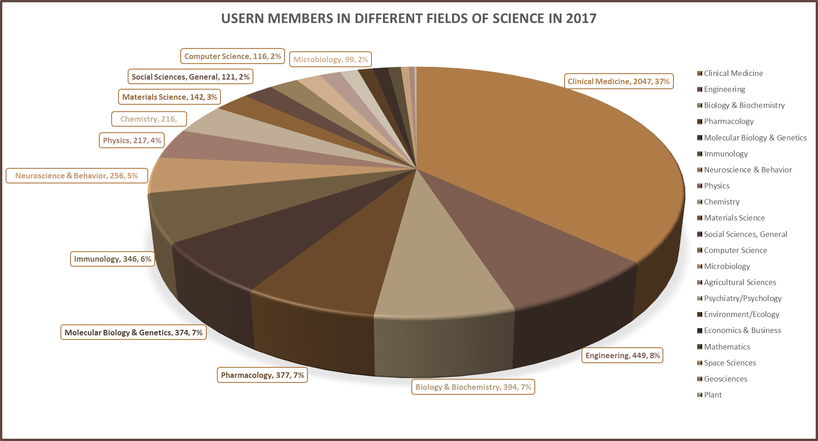
April 1st 2023: >22,200 members

Slide 65





USERN Your Second Affiliation

Slide 66
How to be affiliated to USERN?
Start a project in a team
Make your own research interest group
2nd affiliated to USERN as follow:
  - Your Interest Group, Universal Scientific Education and Research Network (USERN), Your City, Your country
>2000 papers so far!

Slide 67


Slide 68


Slide 69


Slide 70

USERN Junior Ambassadors

Slide 71

Festival Host
  2016: IRAN
  2017: UKRAINE
  2018: ITALY
  2019: HUNGARY
  2020: IRAN
  2021: Turkey
  2022: Oman
  2023: Armenia

Slide 72
COLLABORATE
Communication
Learning
Aims
Organization
Reviewing
Orientation
Altruism
Time management
Ethics
Liability
Borders
Reviewing

Slide 73


http://isid.research.ac.ir/

Slide 74

Scientific Output

Slide 75
Primary Immunodeficiency Diseases: Definition, Diagnosis and Management. 2nd Edition. By Rezaei N, Aghamohammadi A, Notarangelo LD. Springer 2016

Slide 76

Advances in Experimental Medicine and Biology (AEMB)- Book Series
Advances in Experimental Medicine and Biology presents multidisciplinary and dynamic findings in the broad fields of experimental medicine and biology.
The wide variety in topics it presents offers readers multiple perspectives on a variety of disciplines including neuroscience, microbiology, immunology, biochemistry, biomedical engineering and cancer research.
Advances in Experimental Medicine and Biology has been publishing exceptional works in the field for over 30 years and is indexed in Medline, Scopus, EMBASE, BIOSIS, Biological Abstracts, CSA, Biological Sciences and Living Resources (ASFA-1), and Biological Sciences. The series also provides scientists with up to date information on emerging topics and techniques. 2016 Impact Factor: 1.881

Slide 77
COLLABORATE
Communication
Learning
Aims
Organization
Reviewing
Orientation
Altruism
Time management
Ethics
Liability
Borders
Altruism

Slide 78


HEART: Health & ART

Slide 79










HEART: Health and Art

Slide 80


Slide 81

Baku, Azerbaijan
Minsk, Belarus
Vitória, Brazil
Cairo, Egypt
Bonn, Germany
Athens, Greece
Budapest, Hungary
Debrecen, Hungary
Chandigarh, India
New Delhi, India
Gorgan, Iran
Hamedan, Iran
Isfahan, Iran
Mahabad, Iran
Mashhad, Iran
Tabriz, Iran
Tehran, Iran
Zanjan, Iran
Lisbon, Portugal
Ljubljana, Slovenia
Barcelona, Spain
Khartoum, Sudan
Tunis, Tunisia
Istanbul, Turkey
Kharkiv, Ukraine
Kiev, Ukraine
Boston, USA
Los Angeles, USA
Portland, USA
Silicon Valley, USA

Slide 82


























Slide 83


Slide 84




Slide 85


Slide 86


Slide 87



Slide 88


Slide 89



Slide 90


Slide 91


Slide 92


Slide 93


Slide 94
COLLABORATE
Communication
Learning
Aims
Organization
Reviewing
Orientation
Altruism
Time management
Ethics
Liability
Borders
Time management

Slide 95


Time Management

Slide 96


Schedule

Slide 97
COLLABORATE
Communication
Learning
Aims
Organization
Reviewing
Orientation
Altruism
Time management
Ethics
Liability
Borders
Ethics

Slide 98

Ethics in Publication

Slide 99

Ethical Guidelines
As peer-reviewed articles support the scientific method, it is important to agree upon standards of expected ethical behaviour for all parties involved in the act of publishing, including the author, the journal editor, the peer reviewer, the publisher, and the society-owned or sponsored journals.
  Authors’ duties
  Editors’ duties
  Reviewers’ duties
  Publishers’ duties
  Societies’ duties

Slide 100

Reporting Standards
Authors of reports of original research should present an accurate account of the work performed as well as an objective discussion of its significance.
Underlying data should be represented accurately in the paper.
A paper should contain sufficient detail and references to permit others to replicate the work.
Fraudulent or knowingly inaccurate statements constitute unethical behavior and are unacceptable.
Review and professional publication articles should also be accurate and objective, and editorial ‘opinion’ works should be clearly identified as such.
Authors may be asked to provide the raw data in connection with a paper for editorial review, and should be prepared to provide public access to such data

Slide 101
Scientific Misconduct
Scientific misconduct is the violation of the standard codes of scholarly conduct and ethical behavior in professional scientific research.
Fraud has different forms:
  Fabrication: Invention of data or cases! The actual making up of research data and (the intent of) publishing them
  Falsification: Wilful distortion of data! Manipulation of research data and processes in order to reflect or prevent a certain result (Ignoring outliers, Not admitting that some data are missing, Not including data on side effects in a clinical trial)
  Plagiarism: The act of taking credit for the work of another

Slide 102

Authorship
Authorship credit should be based on a significant contribution to the conceptualization, design, execution, and/or interpretation of the research study.
All those who have made significant contributions should be listed as co-authors. All contributors who have participated in certain substantive aspects of the research project and do not meet the criteria for authorship should be listed in an acknowledgments section.
The corresponding author should ensure that all appropriate co-authors and no inappropriate co-authors are included on the paper, and that all co-authors have seen and approved the final version of the paper and have agreed to its submission for publication.

Slide 103

Authorship
Authorship credit should be based on:
  Substantial contributions to conception and design, or acquisition of data, or analysis and interpretation of data
  Drafting the article or revising it critically for important intellectual content
  Final approval of the manuscript
Acquisition of funding, administrative role in your center, etc, alone, does not justify editorship/authorship!
Some journals request and publish information about the contributions of each person named as having participated in a submitted study.
The order of authorship on the byline should be a joint decision of corresponding author and other co-authors.

Slide 104








Slide 105

Disclosure and Conflicts of Interest
All authors should disclose in their manuscript any financial or other substantive conflict of interest that might be construed to influence the results or interpretation of their manuscript. All sources of financial support for the project should be disclosed.
Examples of potential conflicts of interest which should be disclosed include employment, consultancies, stock ownership, honoraria, paid expert testimony, patent applications/registrations, and grants or other funding. Potential conflicts of interest should be disclosed at the earliest stage possible.

Slide 106

The Keys for Success
Aims
Plan
Hardworking
Teamwork

Slide 107


Slide 108

Acknowledgement

Slide 109

Thank you for your attention
Nima Rezaei, MD, PhD E-mail: rezaei_nima@tums.ac.ir

